Slide 1
Demand estimation and logistics optimization of oxygen supply amid COVID-19 pandemic
By: Arnab Paul Choudhury
Varun Pandey

Slide 2
Problem statement
1
Let’s start with the problem at hand

Slide 3
Some figures
7,127 MT*
8,500 MT*
4,880 MT*
Daily oxygen production capacity
Liquid oxygen produced
Demand for oxygen in 12 high-risk states
(*Figures as of 20 April)

Slide 4
Major challenges
Un-optimized demand-supply gap.
Improper demand estimation.
Turnaround time for pick-up and delivery over 1 week.
Oxygen rich states concentrated in the eastern and southern regions of India.

Slide 5
Solution
2
Our methodology for solving the problem

Slide 6
Characteristics of our Solution
Our solution to the problem statement is divided into two parts:
Demand estimation using mathematical modeling.
Optimizing allocation for given constraints.

Slide 7
Estimation of demand
3
Our approach for estimating demand of oxygen

Slide 8
Characteristics
We have used two mathematical models to estimate demand for a particular state using previous data:
SIR Model
SUTRA Model

Slide 9
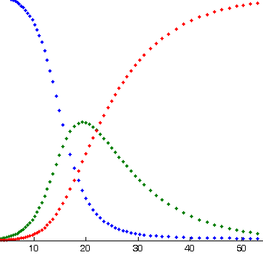
SIR Model

Slide 10
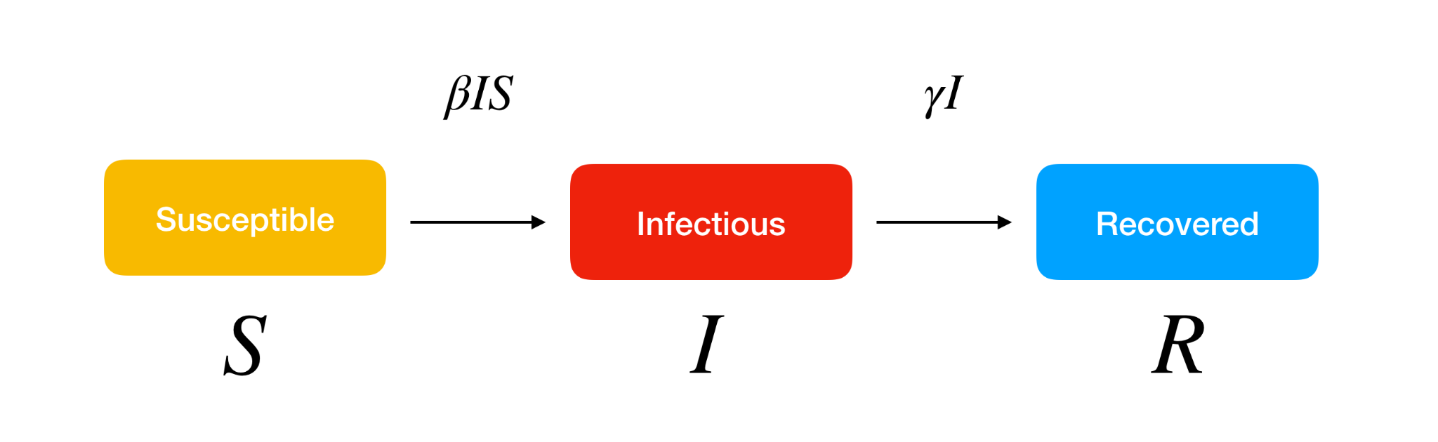
Flowchart of the model

Slide 11
Important parameters
There are two key parameters used in the model:
𝛽 : Effective contact rate of the disease. A infected person comes into contact with 𝛽N individuals per unit time, out of which the susceptible fraction is S/N.
𝛾 : The mean recovery rate. The mean time taken for an infected individual to pass the infection is 1/𝛾.

Slide 12
Variables used in the model
S(t)
Population susceptible to the disease.
I(t)
People who have been infected with the disease
R(t)
People who have either recovered or died due to the disease,

Slide 13
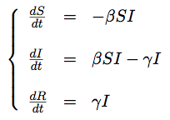
Equations used
The set of equations used is as follows:

Slide 14
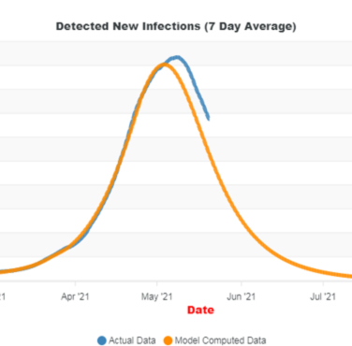
SUTRA Model

Slide 15
Flowchart for the model
Removed
Susceptible
Undetected
Tested +ve
Removed

Slide 16
Important parameters
𝛽
Effective contact rate of the disease. (Similar to SIR model)
𝛾
The mean recovery rate. (Similar to SIR model)
𝜖
Ratio of detected infections to total infections.

Slide 17
Variables used in the model
The model makes use of five variables:
S(t) : Number of people susceptible to infection.
U(t): Number of people who are undetected, but infected.
T(t): Number of people who have tested positive.
R_{T}(t): Number of recovered people who were tested positive.
R_{U}(t): Number of recovered people who were undetected.

Slide 18
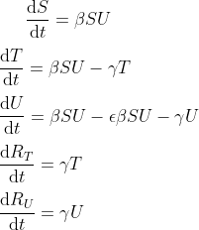
Equations used
The set of equations used is as follows:

Slide 19
Optimising allocation of oxygen
3
Our approach for allocation of supplies

Slide 20
Processing the data
After running the models on our data, we obtained the estimated no. of cases in a particular state in one day for a timestep of 10 days.
In order to get the estimated demand of oxygen in the state, we applied a conversion factor of 0.01, where:
No.of patients requiring oxygen on a given day (in MT)
Estimated no. of cases in the state on that day
= 0.01 *

Slide 21
Methodology and constraints
We have used least cost methodology to optimize the allocations with some constraints.
Firstly, each person requiring oxygen will have an estimated demand of 3 MT per day.
Secondly, the most preferred route will have a distance of less than 200 km, with second preference given to routes from 200 to 400 km, and least preference to longer routes.

Slide 22
Methodology and constraints
In order to calculate distance, we have assumed the states as to be points with latitudes and longitudes. The distance for a route from, say, supplier A to the state 1 would thus be the distance between their latitudes and longitudes.
The suppliers have been assumed to be states as well.

Slide 23
Dataframe for least cost matrix
State/UT | 1 | 2 | 3 | …. | 36 | Supply capacity | supplied
Supplier | [a,b] | [a,b] | [a,b] | …. | [a,b] | r | s
1 | [a,b] | [a,b] | [a,b] | …. | [a,b] | r | s
2 | [a,b] | [a,b] | [a,b] | …. | [a,b] | r | s
... | …. | …. | …. | …. | …. | …. | ….
17 | [a,b] | [a,b] | [a,b] | …. | [a,b] | r | s
demand | p | p | p | ….. | p
Demand fulfilled | q | q | q | ….. | q

Slide 24
Dataframe for least cost matrix
Where for each iteration:
a is the distance between the supplier and state.
b is the amount allocated to this state from the supplier.
p is the estimated demand in the state.
q is the demand fulfilled.
r is the supply capacity of the supplier.
s is the amount supplied by the supplier.

Slide 25
Notes

Slide 26
Possible improvements
While we have used least cost method, we are also looking at other optimization methods which can be used for the dataset.
The solution can be improved by considering other factors, such as unavailability of tankers, though this will affect the complexity as more variables will be needed to be introduced.

Slide 27
Thank you

